Slide 1
DATA STRUCTURES
Queue ADT

Slide 2
Session Objectives
To learn the basic operations of Linear Queue and Circular Queue
Notes:
Student Notes:
The objective of the session is to introduce the concept of services and how these are management. There are standards and frameworks that enable the organization to manage the services. These are also introduced in this session.

Slide 3
Session Outcomes
At the end of this session, participants will be able to
Understand the basics of Linear and Circular Queue

Slide 4
Agenda
Implementation of basic operations of Linear and Circular Queue

Slide 5

Linear and Circular Queue
Dr. B. Prabavathy
SSNCE

Slide 6
Queue
Queue
It is a linear data structure or list where insertions are performed at one end of the list called the rear and deletions are performed at the other end called front
First-in, First-out (FIFO)
Ex.: Queue of people waiting for buying tickets, queue of tasks waiting for a line printer
Basic Operations on queue
Enqueue
Adds a new node at the rear end of the list
Dequeue
Removes the data from the front end of the list
Stores the popped value
Returns true if dequeue was successful

Slide 7
Queue ADT
A queue of elements of any particular data type is a finite sequence of elements of that type together with the following operations:
Initialize the queue to be empty
Determine whether queue is empty or not
Determine if queue is full or not
If queue is not full, perform enqueue operation
If queue is not empty, perform dequeue operation
If queue is not empty, retrieve the first element of the queue

Slide 8
Array Implementation of Queue
Need to declare array size ahead of time
Not a problem for most of the applications
Overflow
Underflow
5
8
1
-7
21
13
9
3
7
front
rear

Slide 9
Queue ADT – Array based implementation
#include <stdio.h>
#include<stdlib.h>
struct Queue
{
int f, r, size;
int data[100];
};
void init(struct Queue *Q,int x)
{
Q->size=x;
Q->f=-1;
Q->r=-1;
}

Slide 10
Queue ADT – Array based implementation
int isEmpty(struct Queue *Q)
{
if(Q->f>Q->rear)
return 0;
else
return 1;
}
int isFull(struct Queue *Q)
{
if(Q->r==(Q->size-1))
return 1;
else
return 0;
}

Slide 11
Queue ADT – Array based implementation
void enqueue(struct Queue *Q, int d)
{
if(isFull(Q))
printf("\n Queue Full");
else
{
Q->r=Q->r+1;
Q->data[Q->r]=d;
printf("\n Data = %d ",d);
}
}

Slide 12
Queue ADT – Array based implementation
void dequeue(struct Queue *Q){
if(isEmpty(Q))
printf("\n Queue Empty");
else{
int d;
Q->f=Q->f+1;
d=Q->data[Q->f];
return d;
}
}

Slide 13
Queue ADT – Array based implementation
void display(struct Queue *Q)
{
int i;
for(i=Q->f+1;i<=Q->r;i++)
printf("\n Data in Queue = %d",Q->data[i]);
}

Slide 14
Queue ADT – Array based implementation
int main(void) {
struct Queue Q; init(&Q,5);
enqueue(&Q,12); enqueue(&Q,4); enqueue(&Q,8);
enqueue(&Q,11); enqueue(&Q,2); enqueue(&Q,18);
enqueue(&Q,27); display(&Q);
int d=dequeue(&Q);
printf("\n Popped value = %d",d);
printf("\n Data after pop");
display(&Q);
d=pop(&Q);
printf("\n Popped value = %d",d);
printf("\n Data after pop");
display(&Q);
enqueue(&Q,18);
enqueue(&Q,27);
printf("\n Data after 2 enqueue operations");
display(&Q);
return 0;
}

Slide 15
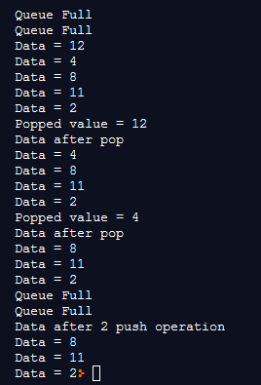
Queue ADT – Array based implementation - Output

Slide 16
CircularQueue ADT – Array based implementation
#include <stdio.h>
struct Queue
{
int data[100];
int f,r,size,iter;
};
void init(struct Queue *Q,int s)
{
Q->size=s;
Q->f=-1;
Q->r=-1;
Q->iter=0;
}

Slide 17
CircularQueue ADT – Array based implementation
void enqueue(struct Queue *Q,int x)
{
if(isFull(Q)) printf("\n Full");
else
{
Q->iter++;
Q->r=(Q->r+1)%Q->size;
Q->data[Q->r]=x;
}
}
int isFull(struct Queue *Q)
{
if(Q->iter<Q->size)
return 0;
else return 1;
}

Slide 18
Circular Queue ADT – Array based implementation
void dequeue(struct Queue *Q)
{
if(isEmpty(Q)) printf("\n Empty");
else
{
Q->iter--;
Q->f=(Q->f+1)%Q->size;
printf("\n Dequeued = %d",Q->data[Q->f]);
}
}
int isEmpty(struct Queue *Q)
{
if(Q->iter==0)
return 1;
else return 0;
}

Slide 19
CircularQueue ADT – Array based implementation
void display(struct Queue *Q)
{
if(!isEmpty(Q))
{
for(int i=Q->f+1;i!=Q->r;i=(++i)%Q->size)
printf("\n Data = %d",Q->data[i]);
printf("\n Data = %d",Q->data[Q->r]);
}
}

Slide 20
CircularQueue ADT – Array based implementation
int main(void)
{
struct Queue *Q;
init(&Q,6);
enqueue(&Q,3); enqueue(&Q,5); enqueue(&Q,6);
enqueue(&Q,1); enqueue(&Q,2); enqueue(&Q,4);
enqueue(&Q,8);
display(&Q);
dequeue(&Q); dequeue(&Q); enqueue(&Q,22);
enqueue(&Q,55);
display(&Q);
return 0;
}

Slide 21
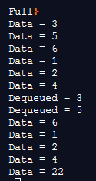
CircularQueue ADT – Array based implementation

Slide 22
Applications of Queue
Direct applications
Waiting in lines
Access to shared resources (e.g., printer)
Multiprogramming
Indirect applications
Auxiliary data structure for algorithms Eg. Simulation
Component of other data structures

Slide 23
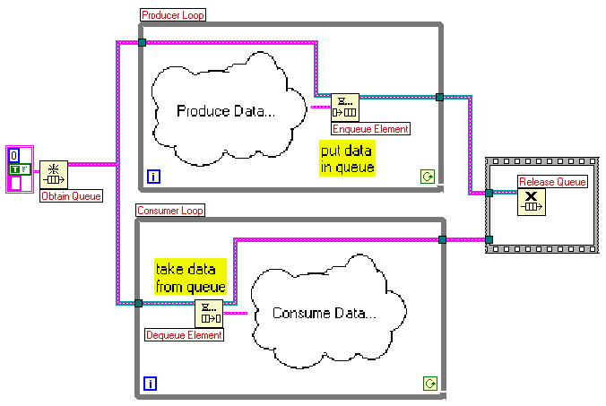
Producer-Consumer problem

Slide 24
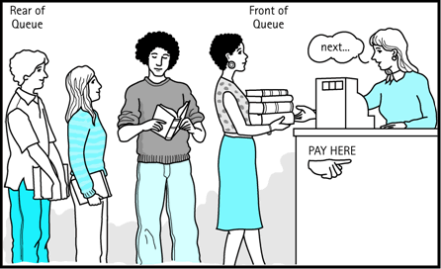
Real time application

Slide 25
Simple Questions
Which data structures uses LIFO and FIFO order
How Queue is useful in operating system of computer?
What Queue data structure in Array Implementation consists of?

Slide 26
Summary
Implementation of basic operations of Linear and Circular Queue

